Slide 1
Data Analysis project
Olympics analysis

Slide 2
Team members
السباعي محمد سباعي درويش
محمود محمد إبراهيم عبد الحافظ
احمد محمد حافظ سعد

Slide 3
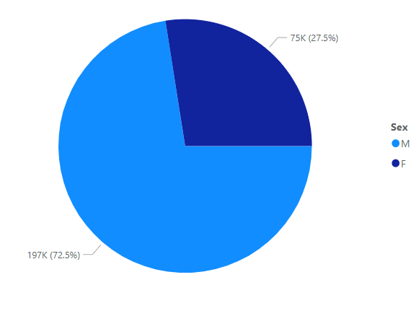
What is the count of males to females' competitors
From the following analysis we find that male competitor's percentage in the Olympics equals 72.5%, while the female competitor's percentage comes to around 27.5%. Therefore, we conclude that the majority of participants are males.

Slide 4
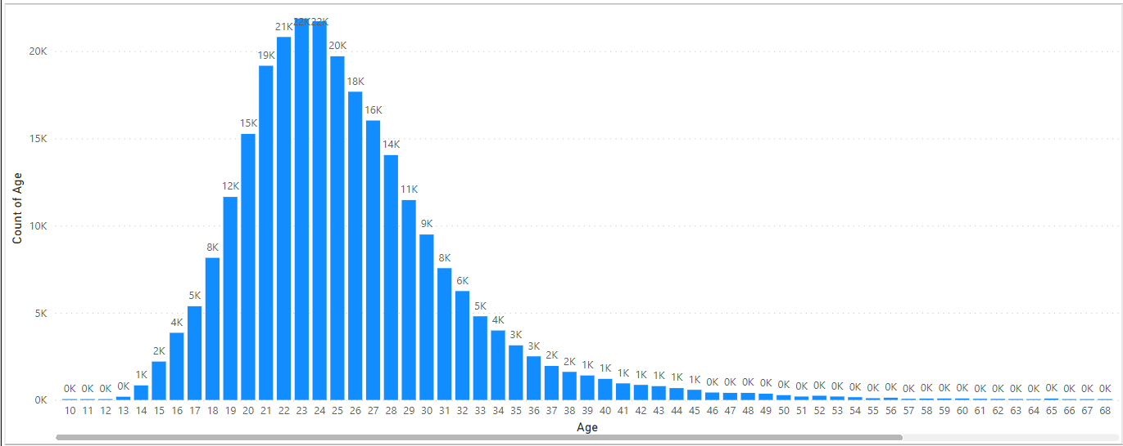
What are the ages of the competitors
The following analysis tells us that most of competitor’s age is between 20’s and mid 30’s. which makes the older competitors makes less than 5% of participants.

Slide 5
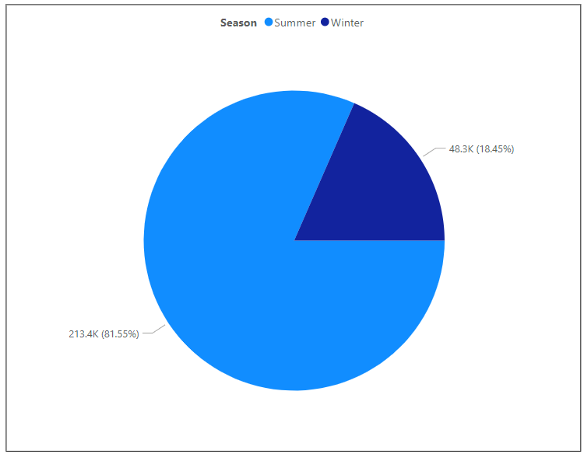
Count of participants by season
From the following analysis we find that the summer round participants among years is close to 81.5%, while winter participants are summing up to 18.4%. Which gives us enough information to say that summer rounds attract more competitors than winter rounds.

Slide 6
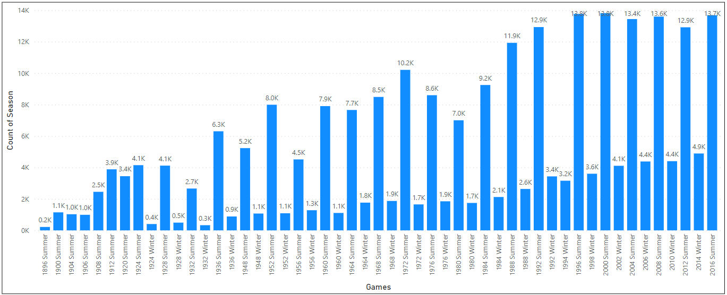
What is games count per year session
The following analysis tells us that the number of games is increasing since the early start of the Olympics, also the numbers of summer round games are much more than winter round games

Slide 7
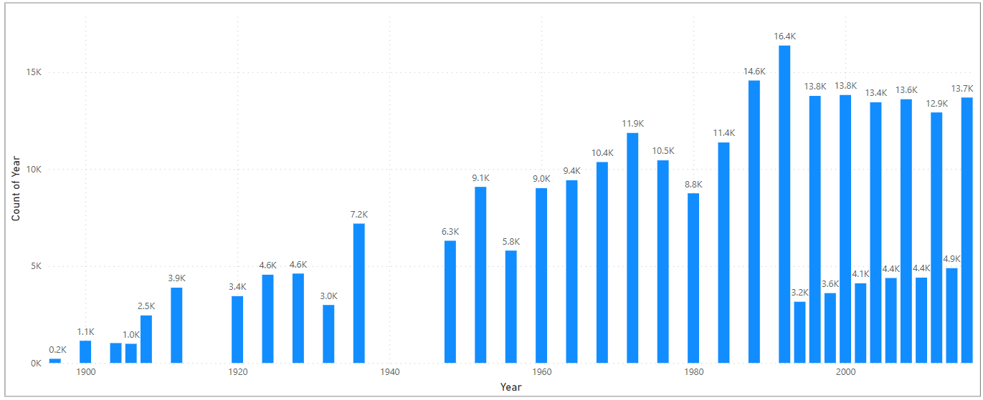
Count of games per years of competition
The following analysis tells us that the games played every year from the beginning of Olympics in 1896 and goes on every four years till the last in the dataset which is 2016

Slide 8
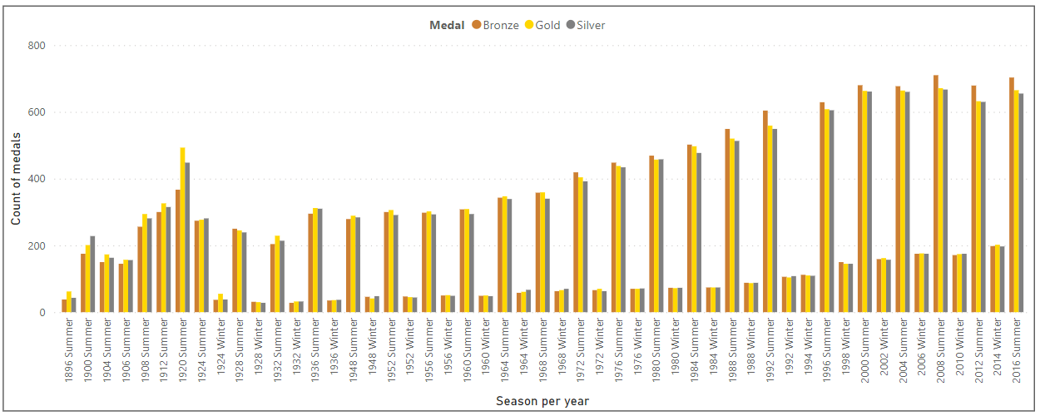
Count of medals per
The following analysis tells us the given medals through out the years, with details on each medal rank (Bronze, Silver, Gold) for each year, we conclude that number of awarded medals are increasing throughout the years, especially in summer rounds.

Slide 9
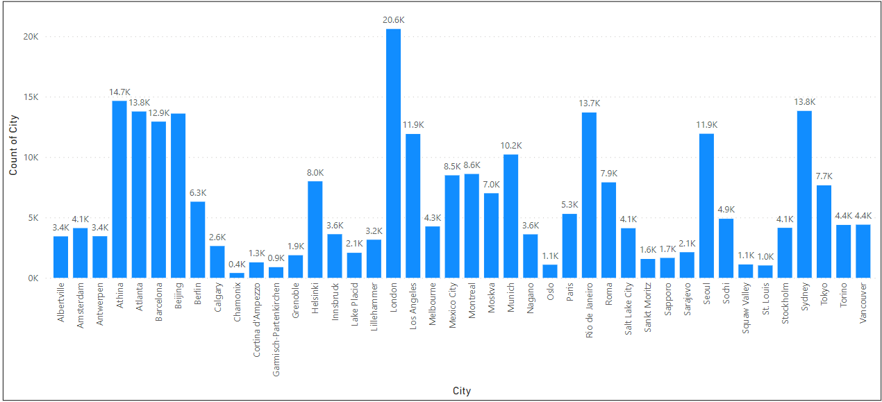
Count of cities of competitors in competition
The following analysis tells us that the cities which enrolls more competitors are the biggest advanced cities like: (London, Athena, Atlanta, Sydney, Rio de Janeiro )

Slide 10
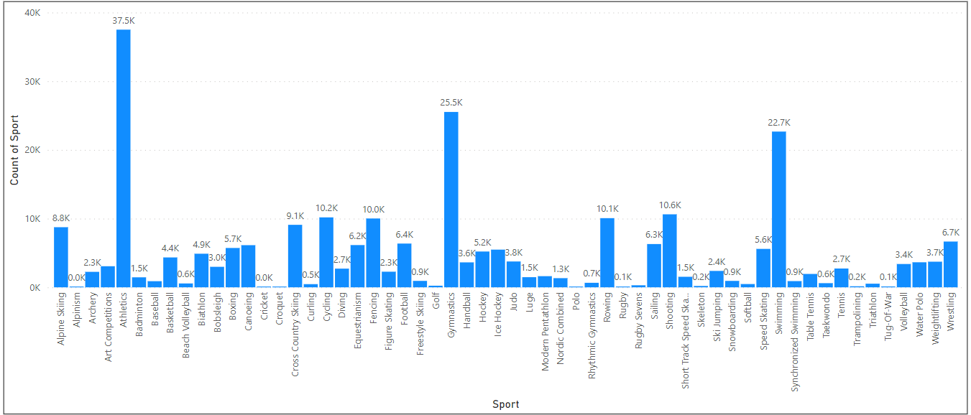
Count of sports participants
The following analysis numbers of players of each sport through out the years, we notice that the sport with most players is (Athletics) , the second most sport is (Gymnastics), while the third most sport is(Swimming).

